Slide 1
Introduction of Database Management System
Module-I

Slide 2
TOPICS TO BE COVERED
Difference between Data, Information,
Data Processing & Data Management.
File Oriented Approach,
Database oriented approach to Data Management,
Need for DBMS,
Characteristic of Database,

Slide 3
TOPICS TOBE COVERED
Database Architecture: Levels of Abstraction,
Database schema and instances,
3 tier architecture of DBMS,
Data Independence.
Database users,
Types of Database System.
Database Languages,
DBMS interfaces.

Slide 4
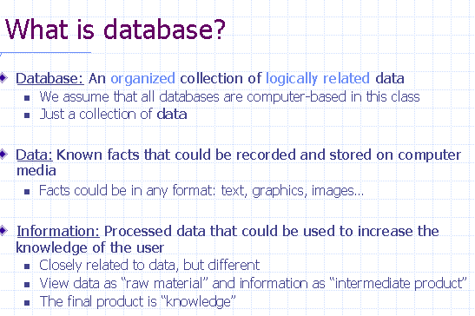

Slide 5
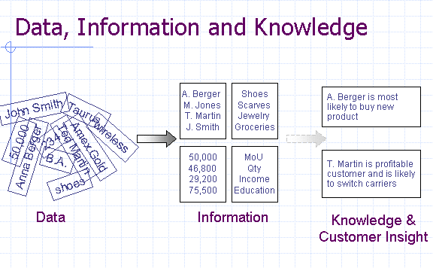

Slide 6
Data Processing
Data processing is any process that a computer program does to enter data and summarize, analyze or otherwise convert data into usable information.

Slide 7
Data Management
Administrative process by which the required data is acquired, validated, stored, protected, and processed, and by which its accessibility, reliability, and timeliness is ensured to satisfy the needs of the data users.

Slide 8
What is Good Data Management
A good Data Management Framework ensures that data is available, accurate, complete and secure across the enterprise and with business partners. Effective data management enables better management decisions, reduces risks and enhances productivity and operational efficiency.

Slide 9
Database Management System
A database management system (DBMS) is the software that allows a computer to perform database functions of storing, retrieving, adding, deleting and modifying data.
Examples:-Microsoft Access, MySQL, Microsoft SQL Server, Oracle

Slide 10
File System Oriented Approach
A File Management system is a DBMS that allows acces to single files or tables at a time. In a File System, data is directly stored in set of files. It contains flat files that have no relation to other files (when only one table is stored in single file, then this file is known as flat file).

Slide 11
File Processing Systems
Billing
Program
Purchasing
Program
Customer
file
Accounts
receivable
file
Buyer
file
Inventory
file
Vendor
file
Accounts_Payable
Program
Sales Order Processing
Program
Payroll
Program
Vendor
file
Invoice
file
Customer
file
Inventory
file
Employee
file
Notes:
1

Slide 12
In a typical file processing systems, each department has its own files, designed especially for those applications. The department itself works with the data processing staff, sets policies or standards for the format and maintenance of its files.

Slide 13
Database Approach
Order Dept.
Accounting
Dept.
Payroll
Dept.
Program
A
Program
B
Program
C
Ordering
filing
System
Invoicing
System
Payroll
System
Back
Orders
file
Inventory
Master
file
Customer
Master
file
Inventory
Pricing
file
Employee
Master
file
Notes:
1

Slide 14
Problem with File System/ Disadvantage
File System Data Management
Requires extensive programming in third-generation language (3GL)
Time consuming
Makes ad hoc queries impossible

Slide 15
Problem with File System
Data Dependence
Change in file’s data characteristics requires modification of data access programs
Must tell program what to do and how
Makes file systems cumbersome from programming and data management views
Structural Dependence
Change in file structure requires modification of related programs.

Slide 16
Problem with File System
4. Data Redundancy
Different and conflicting versions of same data
Results of uncontrolled data redundancy
Data anomalies
Modification
Insertion
Deletion
Data inconsistency
Lack of data integrity

Slide 17
Why DBMS
Makes data management more efficient and effective
Query language allows quick answers to ad hoc queries
Provides better access to more and better-managed data
Promotes integrated view of organization’s operations
Reduces the probability of inconsistent data

Slide 18
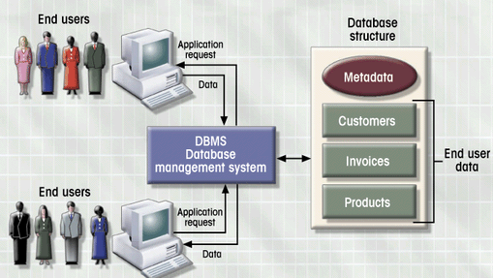
DBMS Manages Interaction
Figure 1.2

Slide 19
What are the advantages of DBMS over File Oriented System?
Enforcement of integrity
Transaction management
Backup and recovery
Security Management
Concurrency Control
Storage Management

Slide 20
1:-Enforcement of integrity
It is necessary for the data values stored in a database to be consistent in certain way.
By defining validation rule.
Example:-Account balance of any account should not be less than 1000. Such integrity can be maintained by centralized control on database.

Slide 21
2:-Transaction Management
Transaction is an action that is used to perform some manipulation on data stored in the database.
A DBMS is responsible for supporting all the required operations on the database.
Execution of transaction required ACID Property.
Atomicity(A):-All operation of a transaction will take place or none will take effect.
Consistency(C ):-All records related to that transaction must be accurate.
Isolation(I):-when two or more transactions run concurrently their effect must be isolated from each other.
Durability(D):-once transaction is complete its effect should not lost event if system fails immediately after transaction.

Slide 22
3:-Backup & Recovery
This feature ensures restoration of the previous state in case of logical or physical corruption or loss of data.
A DBMS keeps backup of copies of the database.
It keeps a log of all operation performed in the database so that data can be restored.

Slide 23
4:-Security Management
Preventing unauthorized database users from accessing the database.
Preventing user from manipulating any information which is not related the that user.
Protecting data to prevent unauthorized users from reading or understanding the content by encrypting it.

Slide 24
5:-Concurrency Control
Simultaneous access of a single database by multiple users/ programs is possible.
Under this feature following issues are handled by DBMS
A wrong view of the database state by one user while other user is updating content of database.
Updation by multiple users, may lead to inconsistent state.

Slide 25
6. Storage Management
DBMS manages data very efficiently and effectively.
The process is automated.

Slide 26
Benefits of Database Technology
Controlling redundancy in data storage and in development and maintenance efforts.
Sharing of data among multiple users.
Restricting unauthorized access to data.
Providing multiple interfaces to different classes of users.
Representing complex relationships among data.
Enforcing integrity constraints on the database.

Slide 27
Benefits of Database Technology
Providing backup and recovery services.
Potential for enforcing standards.
Flexibility to change data structures.
Reduced application development time.
Availability of up-to-date information.
Economies of scale.

Slide 28
Characteristics of DBMS
Self describing nature of database System.
Insulation between programs, data and data abstraction
Support of multiple view of data.
Sharing of data and multiuser transaction processing.

Slide 29
Characteristics data in Database
Shared:-Data in database is shared among users and applications.
Persistent:-data in a database exists permanently
Integrity:-data should be correct with respect to real world entity that they represent.
Security:- data must be protected from unauthorized users.
Consistency:- Data must be consistent to data type that it stores it. E.g. integer should hold only integer not character

Slide 30
DBMS Vs File processing system
Criterion | DBMS | File-Processing System
Nature of Data Design | It is a shared set of data that is logically related. Database is designed to meet information requirement of an organization. | It is a set of application programs that serves the end users in various way, by generating reports. Each program defines and manages its own data.
Redundancies | Inconsistency in the data are reduced due to single file format. Data duplication is reduced to some level. | Redundancies and inconsistency in data exist due to single file formats and duplication of data.
Integrity Constraints | Available | Not available
Data Atomicity | Available | Not available
Size of software | Large | small

Slide 31
Criterion | DBMS | File-Processing System
Accessing Data | Data is easily accessed due to standard query procedure. | Data cannot be easily accessed due to special application programs needed to access data.
Data Isolation Mechanism | Isolation/Retrieval of the required data is possible due to common file format and there are provisions to retrieve data. | Data isolation is difficult due to different file format
Data Dependency | It provides data an program independence | There is dependency between application program and data. This is because the definition of data is embedded in the application program rather than stored separately
Integrity constraints | Integrity constraints ,whether new of old can be enforced as per need. Data integrity is determined on the data itself. | To implement data integrity we need to write new application program to ensure data integrity.

Slide 32
Criterion | DBMS | File-Processing System
Data atomicity | Atomicity of updates is possible | Atomicity of update may not be possible
Concurrent data access | Several user can access data at the same time. | Concurrent access may cause data inconsistency.
Security features | Security features can be implemented very easily | It may be very difficult to enforce security features.
Size of the software | A DBMS is usually a large piece of software adding to an over head | Size of the software is small as compared to the DBMS.

Slide 33
Data Abstraction
The major purpose of a database system is to provide users with an abstract view of the system.
The system hides certain details of how data is stored and created and maintained
Complexity should be hidden from database users.
There are several levels of abstraction:
Physical Level:
Conceptual/logical Level:
View Level:

Slide 34
Physical Level:
This is the lowest level of data abstraction. It describes how data is actually stored in database. . Ex: B+ Tree , Hashing etc
Complex low-level structures described in detail.

Slide 35
Conceptual Level/Logical :
Conceptual Level:
Next highest level of abstraction.
Describes what data are stored.
Describes the relationships among data.
Database administrator level.

Slide 36
View Level:
View level: Highest level of data abstraction. This level describes the user interaction with database system.

Slide 37
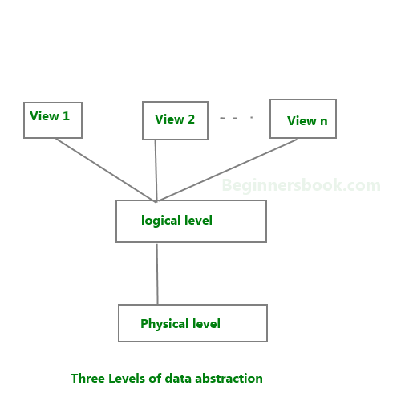
Three level of data abstraction

Slide 38
Schema
A database schema is the skeleton structure that represents the logical view of the entire database. It defines how the data is organized and how the relations among them are associated. It formulates all the constraints that are to be applied on the data. A database schema defines its entities and the relationship among them. Types are:
1 ) A physical schema can be defined as the design of a database at its physical level. In this level, it is expressed how data is stored in blocks of storage.
2 ) Logical Schema defines all the logical constraints that need to be applied on the data stored. It defines tables, views, and integrity constraints.

Slide 39
Instance or Database instance
The information in a database at a particular point of time in called instances of the database.
or
The actual content of the database at a particular point in time .
Related to the value of a variable

Slide 40
DBMS – Architecture
The design of a DBMS depends on its architecture.
It can be centralized or decentralized or hierarchical.
The architecture of a DBMS can be seen as either single tier or multi-tier.
An n-tier architecture divides the whole system into related but independent n modules,
which can be independently modified, altered, changed, or replaced.

Slide 41
One Tier Architecture
In 1-tier architecture, the DBMS is the only entity where the user directly sits on the DBMS and uses it.
Any changes done here will directly be done on the DBMS itself.
It does not provide handy tools for end-users.
Database designers and programmers normally prefer to use single-tier architecture.

Slide 42
Two Tier Architecture
In two tier architecture of DBMS will have an application through which the DBMS can be accessed.
Programmers use 2-tier architecture where they access the DBMS by means of an application.
Here the application tier is entirely independent of the database in terms of operation, design, and programming.

Slide 43
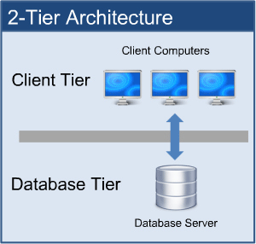

Slide 44
Three tier Architecture of DBMS
A 3-tier architecture separates its tiers from each other based on the complexity of the users and how they use the data present in the database.
It is the most widely used architecture to design a DBMS.

Slide 45
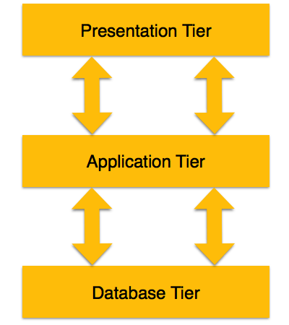
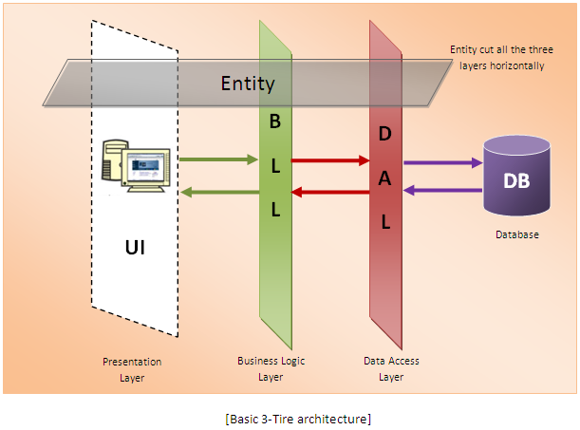

Slide 46
Tier-1 (Database Tier)
Database (Data) Tier − At this tier, the database resides along with its query processing languages.
We also have the relations that define the data and their constraints at this level.

Slide 47
Tier-2(Application (Middle) Tier)
At this tier reside the application server and the programs that access the database.
For a user, this application tier presents an abstracted view of the database.
End-users are unaware of any existence of the database beyond the application.
At the other end, the database tier is not aware of any other user beyond the application tier.
Hence, the application layer sits in the middle and acts as a mediator between the end-user and the database.

Slide 48
Tier-3( User (Presentation) Tier)
End-users operate on this tier and they know nothing about any existence of the database beyond this layer.
At this layer, multiple views of the database can be provided by the application.
All views are generated by applications that reside in the application tier.

Slide 49
Data independence
Data independence is a form of database management that keeps data separated from all programs that make use of the data.
Data independence refers characteristic of being able to modify the schema at one level of the database system without altering the schema at the next higher level. In this manner, the data remains accessible, but is also stable and cannot be corrupted by the applications using it.
One of the functions of data independence is to restrict access to the storage structure of the data by the user applications.

Slide 50
Data independence
By effectively hiding the specifics of the structure from the applications, the potential for any one application to alter the nature of the data becomes impossible.
Thus, the essential data retains its integrity and remains consistent no matter how many databases or database applications access the core data.
It is of two type
LOGICAL DATA INDEPENDENCE
PHYSICAL DATA INDEPENDENCE

Slide 51
LOGICAL DATA INDEPENDENCE
Logical data is data about database, that is, it stores information about how data is managed inside. For example, a table (relation) stored in the database and all its constraints, applied on that relation.
Logical data independence is a kind of mechanism, which liberalizes itself from actual data stored on the disk. If we do some changes on table format, it should not change the data residing on the disk.

Slide 52
PHYSICAL DATA INDEPENDANCE
All the schemas are logical, and the actual data is stored in bit format on the disk. Physical data independence is the power to change the physical data without impacting the schema or logical data.
For example, in case we want to change or upgrade the storage system itself − suppose we want to replace hard-disks with SSD − it should not have any impact on the logical data or schemas.
Accomplishing this shift in file organization or the indexing strategy used for the data does not require any modification to the external structure of the applications, meaning that users of the applications are not likely to notice any difference at all in the function of their programs.

Slide 53
Database User
Database Administrators
Database Designers
End Users
Casual end users:
Naive or parametric end users
Sophisticated end users
Stand-alone users
System Analysts and Application Programmers
Workers behind the Scene
8 Operators and maintenance personnel

Slide 54
Database users
Database Administrators
In a database environment, the primary resource is the database itself and the secondary resource is the DBMS and related software
authorizing access to the database
coordinating and monitoring its use
acquiring software and hardware resources as needed

Slide 55
Database users
Database Designers
identifying the data to be stored in the database
choosing appropriate structures to represent and store this data undertaken before the database is actually implemented and populated with data
communicate with all prospective database users, in order to understand their requirements
develop a view of the database that meets the data and processing requirements for each group of users

Slide 56
Database users
End Users
access to the database for querying, updating, and generating reports
Casual end users:
occasionally access the database
need different information each time
learn only a few facilities that they may use repeatedly.
use a sophisticated database query language to specify their requests
typically middle- or high-level managers or other occasional browsers
Naive or parametric end users
constantly querying and updating the database, using standard types of queries and updates called canned transactions that have been carefully programmed and tested
need to learn very little about the facilities provided by the DBMS
Bank tellers check account balances and post withdrawals and deposits
Reservation clerks for airlines, hotels, and car rental companies check availability for a given request and make reservations

Slide 57
Database users
System Analysts and Application Programmers
Determine the requirements of end users, especially naive and parametric end users, and develop specifications for canned transactions that meet these requirements
Application programmers implement these specifications as programs; then they test, debug, document, and maintain these canned transactions
Workers behind the Scene
Typically do not use the database for their own purposes
DBMS system designers and implementers
Design and implement the DBMS modules (for implementing the catalog, query language, interface processors, data access, concurrency control, recovery, and security. ) and interfaces as a software package

Slide 58
Structure/ components of DBMS System
DBMS (Database Management System) acts as an interface between the user and the database.
The user requests the DBMS to perform various operations (insert, delete, update and retrieval) on the database.
The components of DBMS perform these requested operations on the database and provide necessary data to the users.

Slide 59
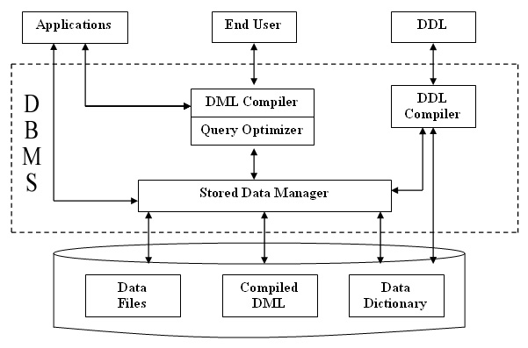
The various components of DBMS are shown below: -

Slide 60
Components of DBMS
DDL Compiler
DML Compiler and Query optimizer
Data Manager -
Data Dictionary
Data Files -.
Compiled DML -
End Users -

Slide 61
Components of DBMS
DDL Compiler - Data Description Language compiler processes schema definitions specified in the DDL. It includes metadata information such as the name of the files, data items, storage details of each file, mapping information and constraints etc.
DML Compiler and Query optimizer - The DML commands such as insert, update, delete, retrieve from the application program are sent to the DML compiler for compilation into object code for database access. The object code is then optimized in the best way to execute a query by the query optimizer and then send to the data manager.
Data Manager - The Data Manager is the central software component of the DBMS also knows as Database Control System.

Slide 62
The Main Functions Of Data Manager Are: –
•Convert operations in user's Queries coming from the application programs or combination of DML Compiler and Query optimizer which is known as Query Processor from user's logical view to physical file system.
• Controls DBMS information access that is stored on disk.
• It also controls handling buffers in main memory.
• It also enforces constraints to maintain consistency and integrity of the data.
• It also synchronizes the simultaneous operations performed by the concurrent users.
• It also controls the backup and recovery operations.

Slide 63
4. Data Dictionary -
Data Dictionary is a repository of description of data in the database. It contains information about
Data :- names of the tables, names of attributes of each table, length of attributes, and number of rows in each table.
Relationships between database transactions and data items: referenced by them which is useful in determining which transactions are affected when certain data definitions are changed.
Constraints on data: i.e. range of values permitted.
Detailed information on physical database :design such as storage structure, access paths, files and record sizes.
Access Authorization: - is the Description of database users their responsibilities and their access rights.
Usage statistics: such as frequency of query and transactions.
Data dictionary :is used to actually control the data integrity, database operation and accuracy. It may be used as a important part of the DBMS.

Slide 64
Components of DBMS
5. Data Files - It contains the data portion of the database.
6. Compiled DML -
The DML complier converts the high level Queries into low level file access commands known as compiled DML.
7. End Users -

Slide 65
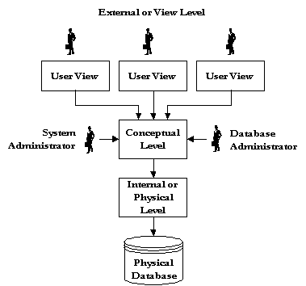
Logical DBMS Architecture

Slide 66
View

Slide 67
The External View or Level
The external view provides a window on the conceptual view which allows the user to see only the data of interest to them. The user can be either an application program or an end user. Any number of external schema can be defined and they can overlap each other.
The System Administrator and the Database Administrator are special cases. Because they have responsibilities for the design and maintenance for the design and maintenance of the database, they at times need to be able to see the entire database. The external and the conceptual view are functionally equivalent for these two users.

Slide 68
The Conceptual View or Level
The conceptual level presents a logical view of the entire database as a unified whole, which allows you to bring all the data in the database together and see it in a consistent manner.
The first stage in the design of a database is to define the conceptual view, and a DBMS provides a data definition language for this purpose.
It is the conceptual level that allows a DBMS to provide data independence.
The data definition language used to create the conceptual level must not specify any physical storage considerations that should be handled by the physical level.
It should not provide any storage or access details, but should define the information content only.

Slide 69
The Internal or Physical Level
The collection of files permanently stored on secondary storage devices is known as the physical database.
The physical /internal view level is the one closest to physical storage, and it provides a low-level description of the physical database, and an interface between the operating system's file system and the record structures used in higher levels of abstraction.
It is at this level that record types and methods of storage are defined, as well as how stored fields are represented, what physical sequence the stored records are in, and what other physical structures exist.

Slide 70
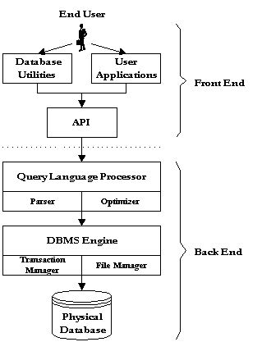
Physical DBMS Architecture

Slide 71
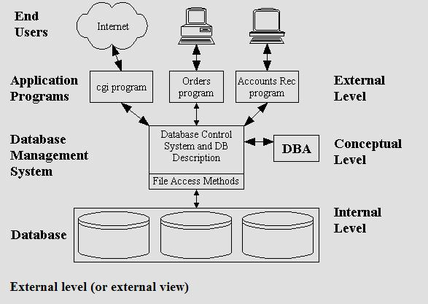

Slide 72
Typical DBMS component modules
DBMS engine accepts logical requests from various other DBMS subsystems, converts them into physical equivalents, and actually accesses the database and data dictionary as they exist on a storage device.
Data definition subsystem helps the user create and maintain the data dictionary and define the structure of the files in a database.

Slide 73
Typical DBMS component modules
Data manipulation subsystem helps the user to add, change, and delete information in a database and query it for valuable information. Software tools within the data manipulation subsystem are most often the primary interface between user and the information contained in a database. It allows the user to specify its logical information requirements.

Slide 74
Typical DBMS component modules
Application generation subsystem contains facilities to help users develop transaction-intensive applications. It usually requires that the user perform a detailed series of tasks to process a transaction. It facilitates easy-to-use data entry screens, programming languages, and interfaces.
Data administration subsystem helps users manage the overall database environment by providing facilities for backup and recovery, security management, query optimization, concurrency control, and change management.

Slide 75
Type of Database Systems
Based on Number of Users
Single-user
Desktop database
Multiuser
Workgroup database
Enterprise database
Scope
Desktop
Workgroup
Enterprise

Slide 76
Types of Database Systems
Base on Location
Centralized
Distributed
Use
Transactional (Production)
Decision support
Data warehouse

Slide 77
PC Databases
E.g.:
Access
FoxPro
Dbase
Etc.

Slide 78
Centralized Databases
Central
Computer

Slide 79
Client / Server Databases
Client
Network
Client
Database
Server
Client

Slide 80
Distributed Databases
Location B
Location C
computer
computer
computer
Homogeneous
Databases
Location A

Slide 81
Distributed Databases
Client
Heterogeneous
Or Federated
Databases
Remote
Comp.
Local Network
Database
Server
Communication
Server
Remote
Comp.
Client

Slide 82
Database languages
Data Definition Language (DDL)
Data Manipulation Language (DML)

Slide 83
Data Definition Language (DDL)
data definition language, used by the DBA and database designers to define the conceptual and internal schemas.
The DBMS has a DDL compiler to process DDL statements in order to identify the schema constructs, and to store the description in the catalogue.
In databases where there is a separation between the conceptual and internal schemas, DDL is used to specify the conceptual schema, and SDL, storage definition language, is used to specify the internal schema

Slide 84
Data Manipulation Language
Data Manipulation Language (DML) is used for data manipulation. Data manipulation includes Retrieval of Information Stored in Database Insertion of Information to the database Deletion of information from the database Updating of information stored in the database

Slide 85
Types of Data Manipulation Language (DML)
Procedural DML
Non Procedural DML(Declarative DML ) Procedural DML: In procedural Data manipulation language user has to specify what data are needed and how to get it. Non Procedural DML(Declarative DML ) In declarative Data manipulation language user has to specify what data are needed without specifying how to get it. Example : SQL (Structured Query Languages)

Slide 86
DBMS Interfaces
Types of interfaces provided by the DBMS include:
Menu-Based Interfaces for Web Clients or Browsing
Forms-Based Interfaces
Graphical User Interfaces
Natural Language Interfaces
Interfaces for Parametric Users
Interfaces for the DBA

Slide 87
Menu-Based Interfaces for Web Clients or Browsing
Present users with list of options (menus).
Lead user through formulation of request
Query is composed of selection options from menu displayed by system.

Slide 88
Forms-Based Interfaces
Displays a form to each user.
User can fill out form to insert new data or fill out only certain entries.
Designed and programmed for naïve users as interfaces to canned transactions.

Slide 89
Graphical User Interfaces
Displays a schema to the user in diagram form. The user can specify a query by manipulating the diagram. GUIs use both forms and menus.

Slide 90
Natural Language Interfaces
Accept requests in written English, or other languages and attempt to understand them.
Interface has its own schema, and a dictionary of important words. Uses the schema and dictionary to interpret a natural language request

Slide 91
Interfaces for Parametric Users
Parametric users have small set of operations they perform.
Analysts and programmers design and implement a special interface for each class of naïve users.
Often a small set of commands included to minimize the number of keystrokes required. (I.e. function keys)

Slide 92
Interfaces for the DBA
Systems contain privileged commands only for DBA staff.
Include commands for creating accounts, setting parameters, authorizing accounts, changing the schema, reorganizing the storage structures etc.

